Slide 1
Calculator V2
The « Huh? », « What? », « Where?» and « How the hell?! »
Joshua Racz

Slide 2
Calc V2: Huh?
Main way for the sales floor to price and fund merchants.
An upgrade from our old, unscalable, Calculator v1

Slide 3
Calc V2: What?
Calculates Merchant Cash Advance and (soon) Loans for merchants
Involves:
Categorizing
Initial/Core pricing
Pricing Options
Top Ups

Slide 4
Calc V2: Where?
2 Places:
Salesforce
Heroku
CalcV2-Dev -- Calc V2 Sandbox
CalcV2-Coda -- CODA & NoUndo Sandbox
CalcV2-Production -- Production

Slide 5
How the Hell?!
Development
Deployment
Troubleshooting

Slide 6
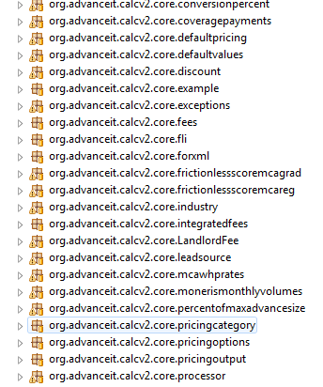

Development
Heroku
Divided into work packages
Modified version of Model View Controller

Slide 7
Devlopment – Getting Started
Tools used:
Git Bash
Eclipse
These tools should be installed on your computer if you are a software developer

Slide 8

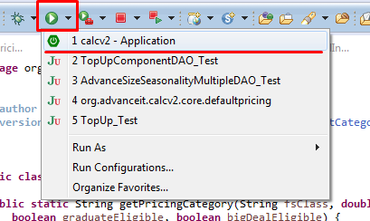
Development – Getting Started
Note: this is after having your environment set up
1. Create a new Topic Branch from master
2. Make sure it all compiles and runs in Eclipse

Slide 9
Deployment
Deployment process:
CalcV2 → CODA → Production
Salesforce: approx 1 hour from Sandbox to Production
Heroku 2 – 7 minus from between all instances.
Tools Used:
Git Bash
Eclipse
Heroku Toolbelt

Slide 10
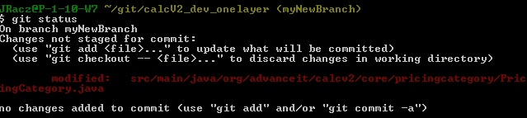
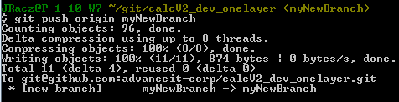
Deployment – Step by Step (developer)
1. Check Changes Made
2. Commit changes
3. Push to GitHub Topic Branch (your created branch)
Create Pull Request
(via github)

Slide 11
Deployment – Step by Step (Deployer)
Code Reviews
Make sure code is factored and formatted by team standards and returns no errors
Merges code to master branch and settles any code conflicts
Pushes new code to Heroku-dev (CalcV2 Sandbox)

Slide 12
Deployment – Step by Step (Deployer)
Notifies Business System Analysts that new code is up for testing on CalcV2 Sandbox
Waits for testing to be completed
If succeeded, deploys to CODA and for testing and later Production
If failed, goes back to the developer for re-work

Slide 13
Troubleshooting
Something breaks sometimes (often). how to troubleshoot and find out what is exactly broken
Tools Used:
Heroku Status
Eclipse
Postman
Heroku Connect
PgAdmin

Slide 14
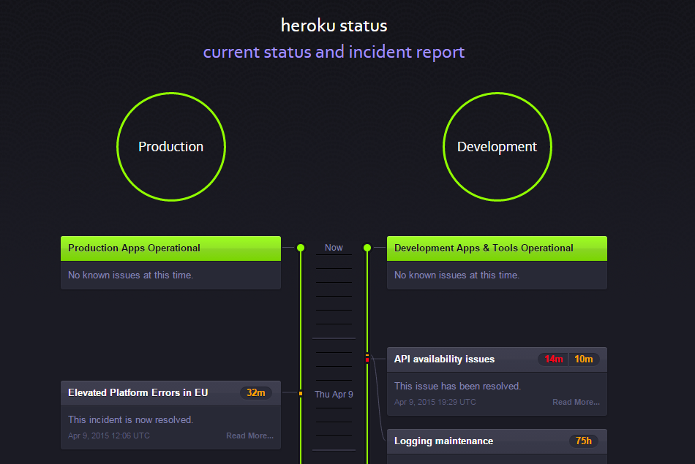
Troubleshooting
Heroku Status
https://status.heroku.com

Slide 15
Troubleshooting
Eclipse
Useful for debugging incorrect processed data (ie: total funded amount)
Also useful for finding missing salesforce data (ie: records in top_up_components)
Can be configured to access Dev, Coda, and Production databases

Slide 16
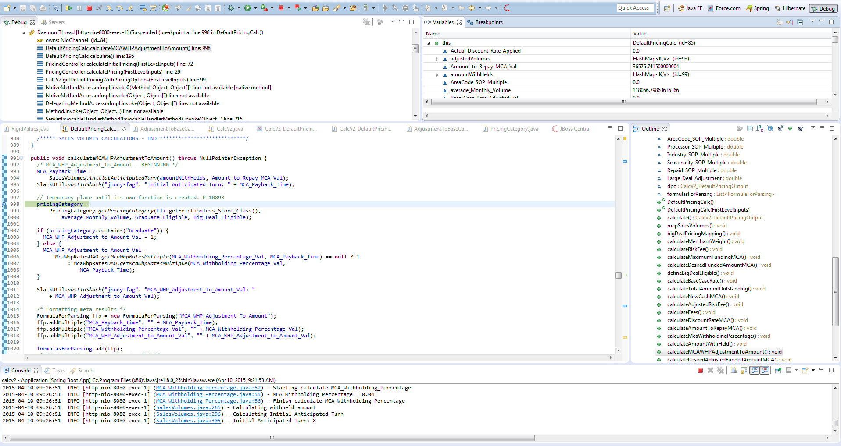

Slide 17
Troubleshooting
Postman – Chrome extension
Retrieve pricing request via Salesforce
Place into Postman
Retrieve results/lack of results
If lack of results, there may be an issue with data

Slide 18
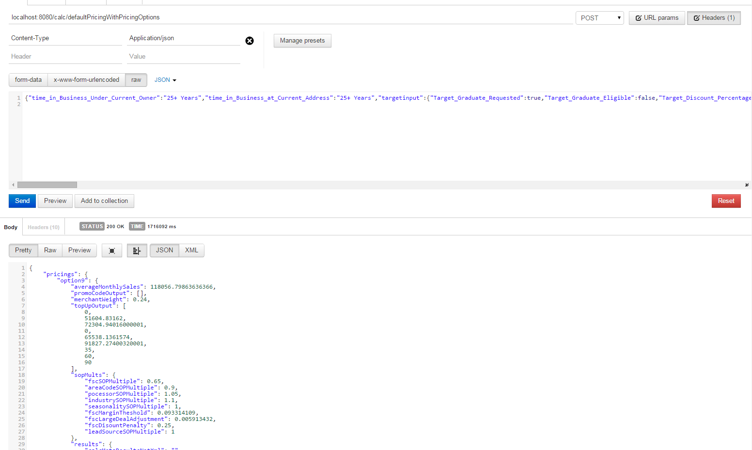

Slide 19
Troubleshooting
Heroku Connect
Mapping objects and Fields
Reset if database fails

Slide 20
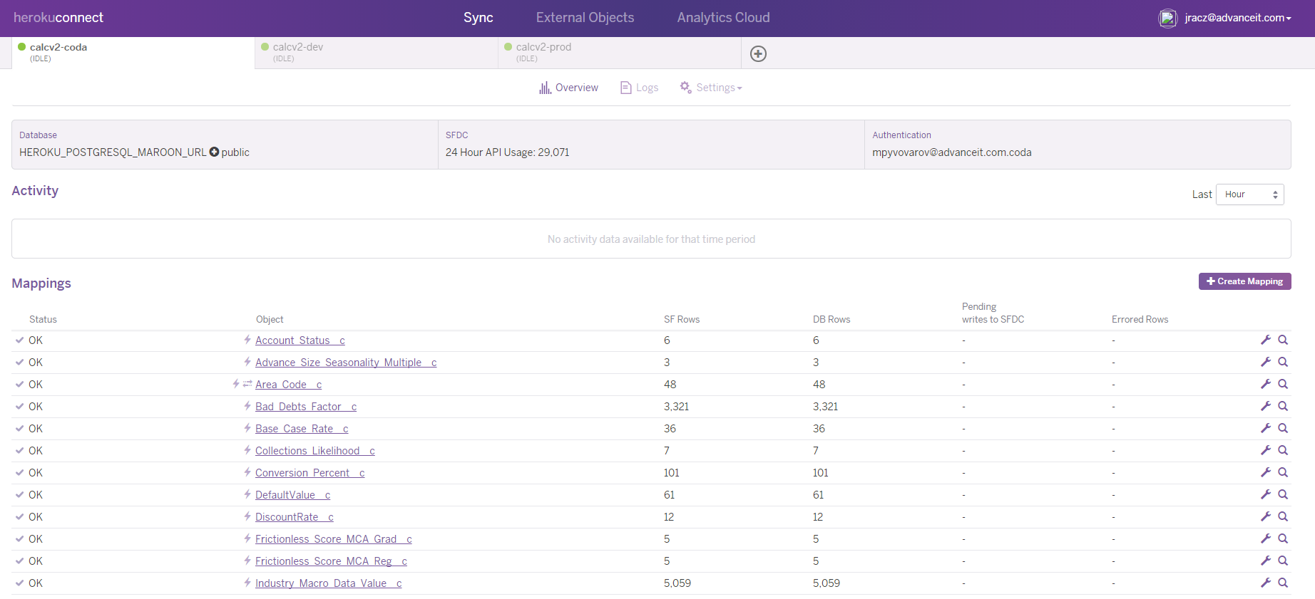

Slide 21
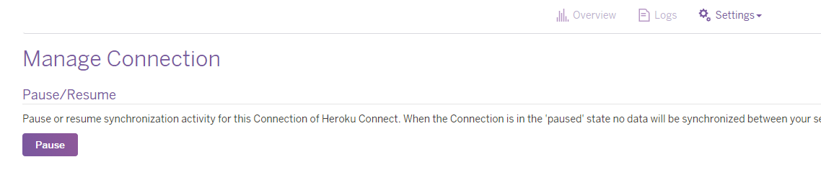
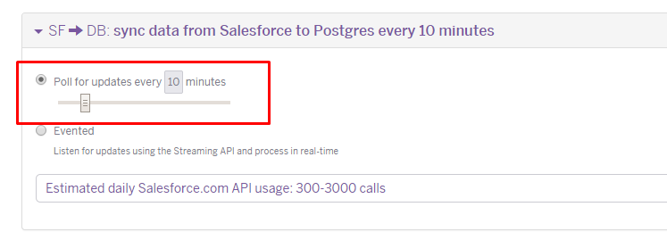
Troubleshooting – Heroku Connect
Mapping a Field
1. Pause the Database (stops syncing)
2. Set « Poll for updates every 10 mins »

Slide 22
Troubleshooting – Heroku Connect
What happens when it all breaks?!
Kill the Database connections on heroku from command line
Heroku pg:killall –app <insert app here>
Restart application
Heroku restart –app <insert app here>

Slide 23
Troubleshooting
PgAdmin
Tool that gives access to all databases
Can query to see if criteria exists or not

Slide 24
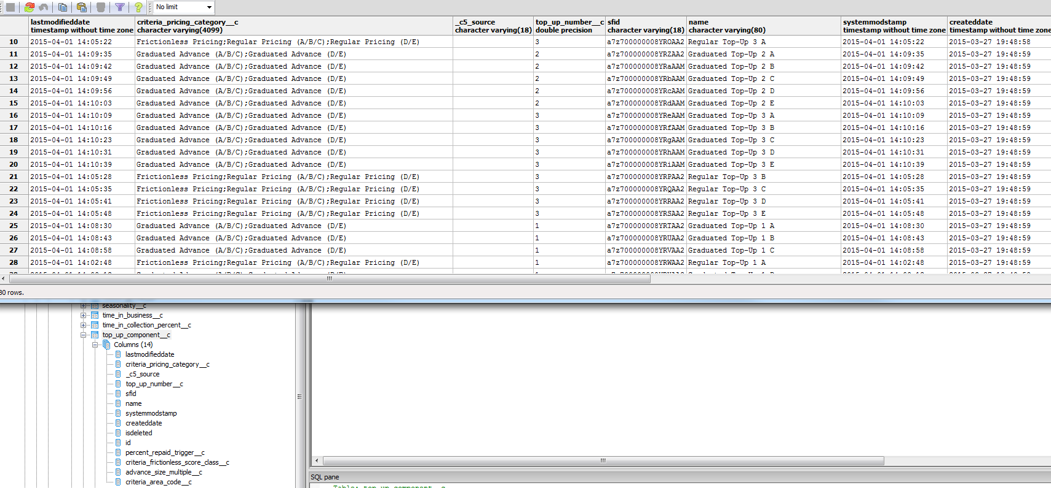

Slide 25

Questions? Comments?
…Jokes?

